Slide 1
CS 269: Deep Generative Models
Aditya Grover
UCLA
Course URL: https://grover-group.github.io/dgm-win22

Slide 2
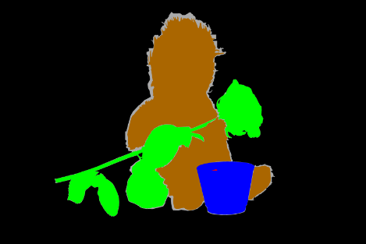
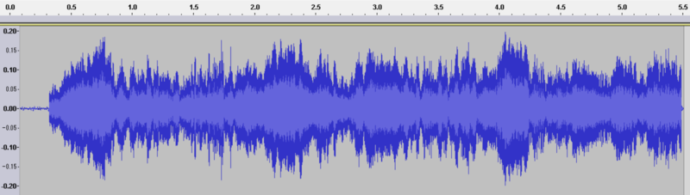
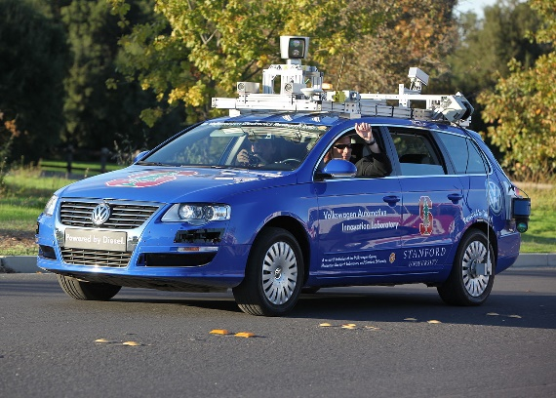
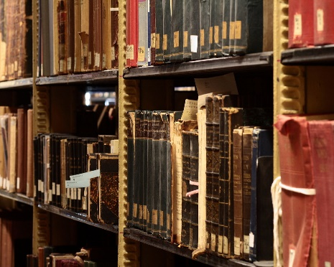
Introduction
Challenge: understand complex, unstructured inputs
Computational Speech
Computer Vision
Natural Language Processing
Robotics
Notes:
Problem: making sense of complex, unstructured sensory inputs. Images, speech, text, video, etc.
https://commons.wikimedia.org/wiki/Language#/media/File:Floor_7a_bookstacks_in_Sterling_Memorial_Library.jpg
https://commons.wikimedia.org/wiki/File:EmiMa-099-semantic-segmentation.png
https://commons.wikimedia.org/wiki/File:Waveform_of_Habana_syndrome_sound.png
https://commons.wikimedia.org/w/index.php?title=Special:Search&limit=500&offset=0&ns0=1&ns6=1&ns12=1&ns14=1&ns100=1&ns106=1&search=Autonomous+cars&advancedSearch-current={}

Slide 3
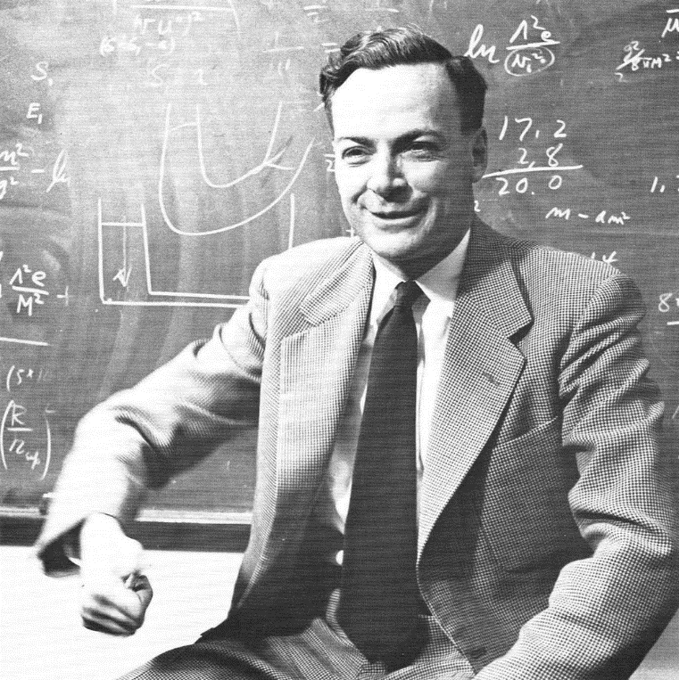
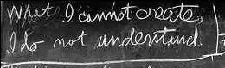
Introduction
Richard Feynman: “What I cannot create, I do not understand”
Generative modeling: “What I understand, I can create”
Notes:
Https://commons.wikimedia.org/wiki/Category:Richard_Feynman#/media/File:Richard_Feynman_1959.png
http://archives-dc.library.caltech.edu/islandora/object/ct1%3A483

Slide 4
Generative Modeling: Computer Graphics
How to generate natural images with a computer?
Our models will have similar structure (generation + inference)
High level description
Cube(color=blue, position=(x,y,z), size=…)
Cylinder(color=red, position=(x’,y’,z’), size=..)
Generation (graphics)
Inference (vision as inverse graphics)
Raw sensory outputs
Notes:
Computer graphics:
Produce plausible images
You choose models, conditions, imging parameters, etc.
Vision:
Given images with noise, estimate physical quantities (ill-posed problem)
Building a generative model is not the entire story. Inference (e.g. vision) is still hard. So not entirely true that if we can create we understand. But it’s a useful step

Slide 5
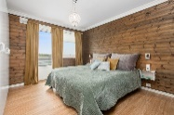
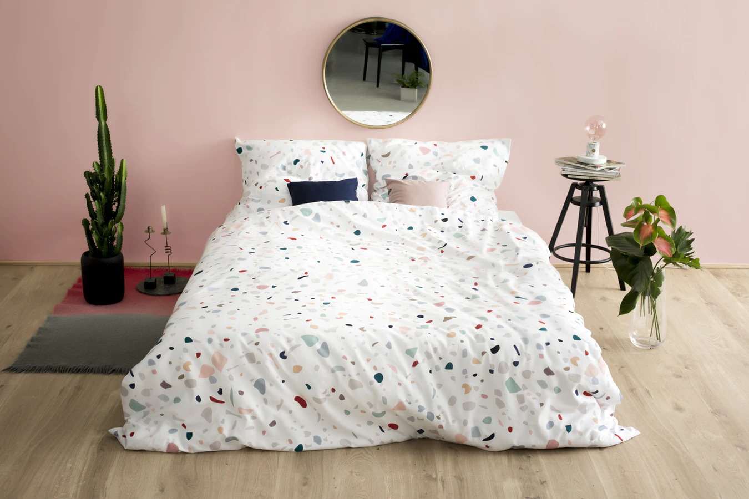



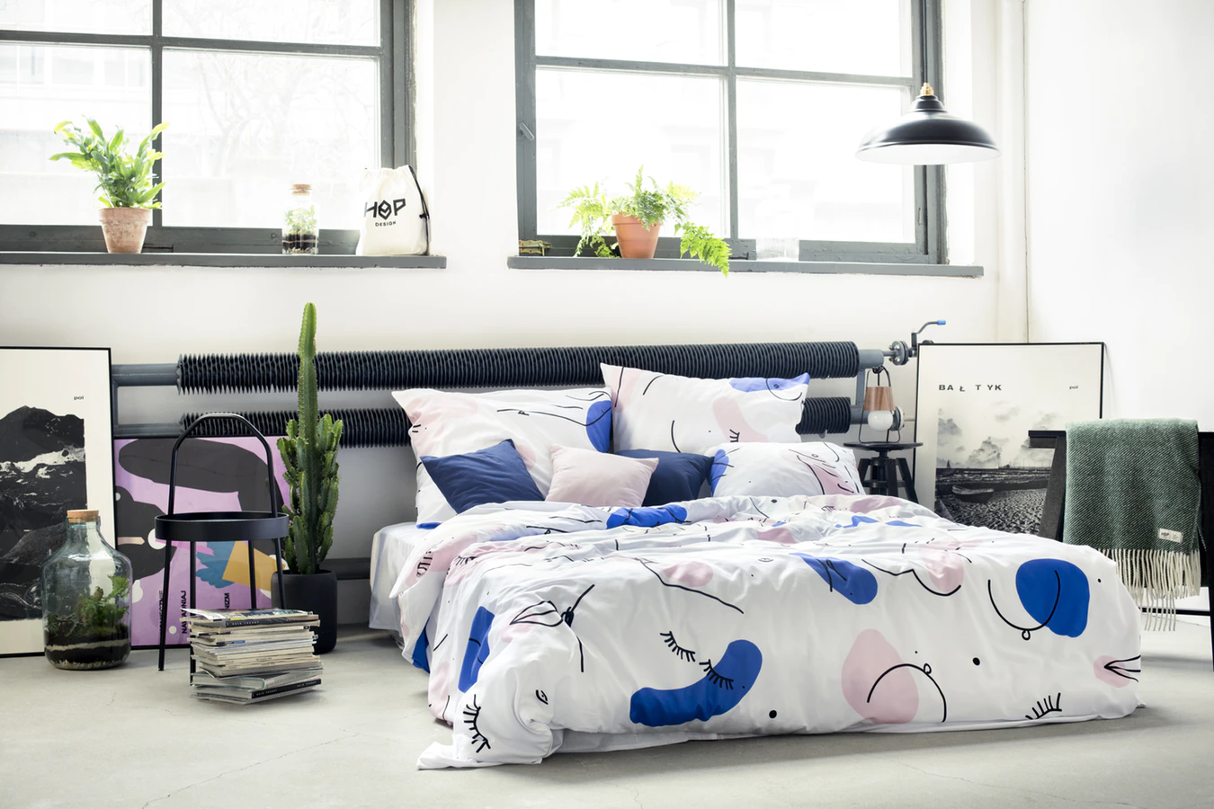
Statistical Generative Models
Statistical generative models are learned from data
Priors are always necessary, but there is a spectrum
+
…
Data
(e.g., images of bedrooms)
Prior Knowledge
(e.g., physics, materials, ..)
This course
Graphics
Prior Knowledge
Data
Notes:
We are concerned with statistical generative models
Graphics: purely based on prior knowledge. Difficult to scale. Developing the field took a very long time. Still not entirely solved, active area of research.
Motivation: Reduce the amount of prior knowledge and use data. (machine learning)
Note: cannot do something purely based on data. Known impossibility results. Even in discrete spaces, scaling of sample complexity would be doubly-exponential.
https://www.iconfinder.com/icons/1562699/book_energy_idea_knowledge_icon
https://www.yf.io/p/lsun

Slide 6


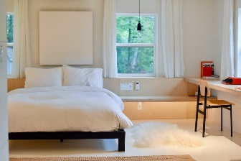
Statistical Generative Models
A statistical generative model is a probability distribution p(x)
Data: samples (e.g., images of bedrooms)
Prior knowledge: parametric form (e.g., Gaussian?), loss function (e.g., maximum likelihood?), optimization algorithm, etc.
It is generative because sampling from p(x) generates new images
A probability distribution
p(x)
Image x
probability p(x)
…
Notes:
We are concerned with statistical generative models
Graphics: purely based on prior knowledge. Difficult to scale. Developing the field took a very long time. Still not entirely solved, active area of research.
Motivation: Reduce the amount of prior knowledge and use data. (machine learning)
Note: cannot do something purely based on data. Known impossibility results. Even in discrete spaces, scaling of sample complexity would be doubly-exponential.

Slide 7
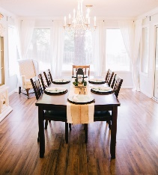








Discriminative vs. generative
Discriminative: classify bedroom vs. dining room
Generative: generate X
Y=B , X=
Y=D , X=
Decision boundary
Y=B , X=
Y=D , X=
…
…
Y=B , X=
Y=D , X=
The image X is given. Goal: decision boundary, via conditional distribution over label Y
Ex: logistic regression, convolutional net, etc.
The input X is not given. Requires a model of the joint distribution over both X and Y
P(Y = Bedroom | X= ) = 0.0001
P(Y = Bedroom , X= ) = 0.0002
Notes:
How is this different from traditional ML?
Y is simple

Slide 8


Discriminative vs. generative
Joint and conditional are related via Bayes Rule:
P(Y = Bedroom, X= )
P(Y = Bedroom | X= ) =
P( X = )
Discriminative: Y is simple; X is always given, so not need to model
P(X= )
Therefore it cannot handle missing data
P(Y = Bedroom | X = )
Notes:
How is this different from traditional ML?
Y is simple

Slide 9

Conditional Generative Models
Class conditional generative models are also possible:
It’s often useful to condition on rich side information Y
A discriminative model is a very simple conditional generative model of Y:
P(X= | Y = Bedroom)
P(X= | Caption = “A black table with 6 chairs”)
P(Y = Bedroom | X= )
Notes:
Y is simple

Slide 10
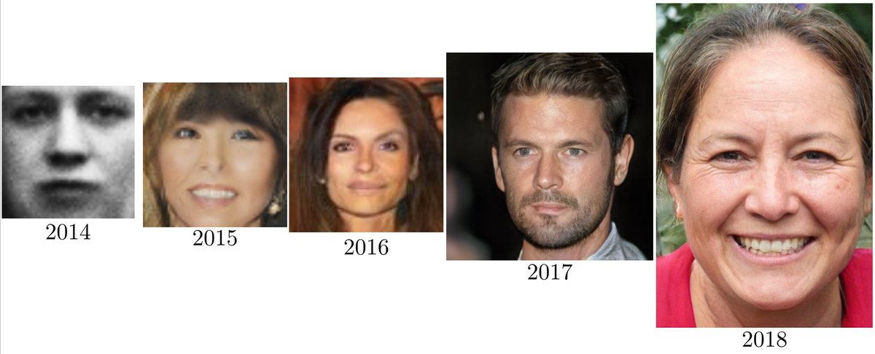
Progress in Generative Models of Images
Ian Goodfellow, 2019
Notes:
https://www.youtube.com/watch?v=XOxxPcy5Gr4

Slide 11
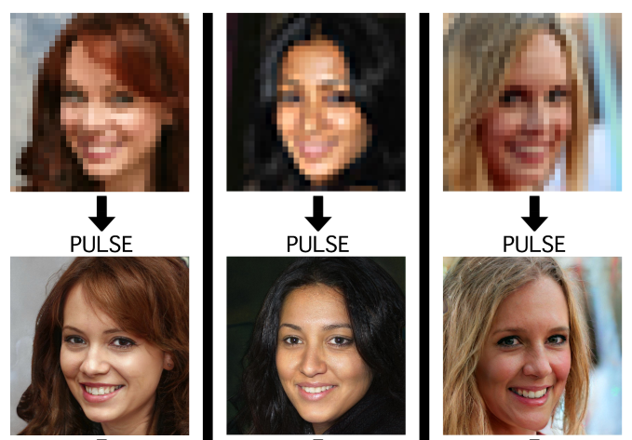
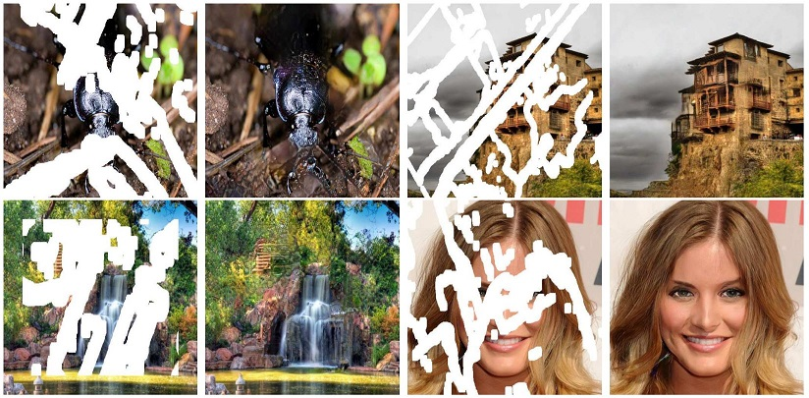
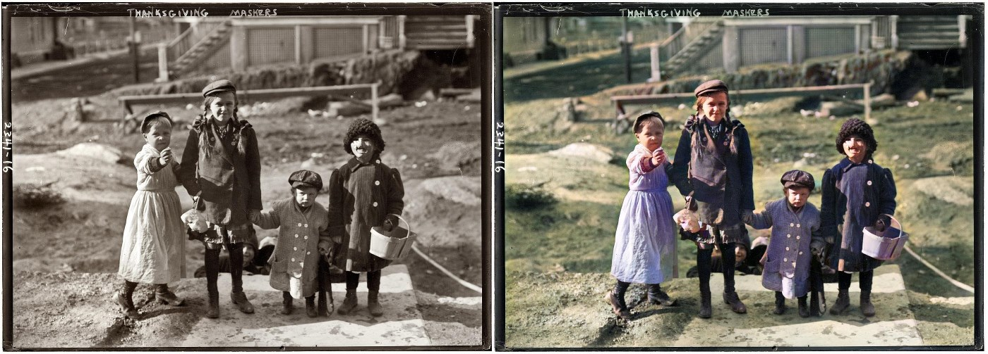
Progress in Inverse Problems
P(high resolution | low resolution)
P(full image| mask)
Menon et al, 2020
Liu al, 2018
P(color image| greyscale)
Antic, 2020
Notes:
In the last few years, we’ve seen a lot of progress in learning generative models of complex objects like images, text, music, videos, molecules. For example, here you can see some amazingly realistic images you can generate using generative adversarial networks.

Slide 12


WaveNet
Text to Speech
Generative model of speech signals
Parametric
Concatenative
WaveNet
Unconditional
Music
van den Oord et al, 2016c
Notes:
https://deepmind.com/blog/wavenet-generative-model-raw-audio/

Slide 13
Audio Super Resolution
Conditional generative model P(high-res signal | low-res audio signal)
Low res signal
High res audio signal
Kuleshov et al., 2017

Slide 14

Image Translation
Conditional generative model P( zebra images| horse images)
Zhu et al., 2017
Notes:
https://www.youtube.com/watch?time_continue=1&v=9reHvktowLY

Slide 15
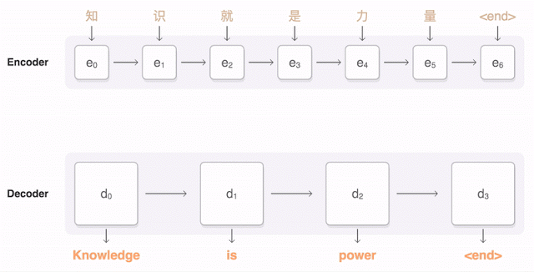
Machine Translation
Conditional generative model P( English text| Chinese text)
Figure from Google AI research blog.

Slide 16
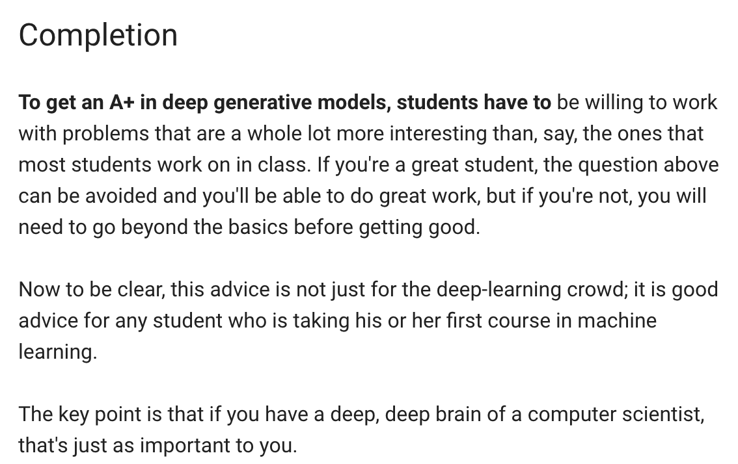
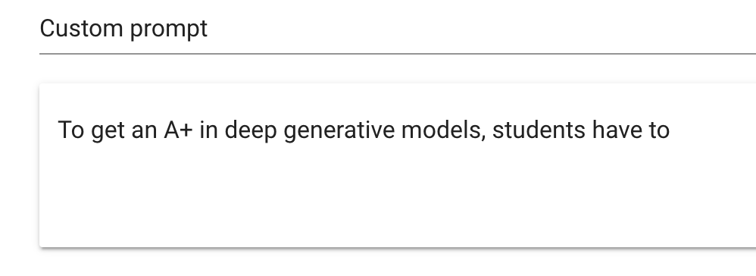
Language Generation
Radford et al., 2019
Demo from talktotransformer.com
P(next word | previous words)

Slide 17
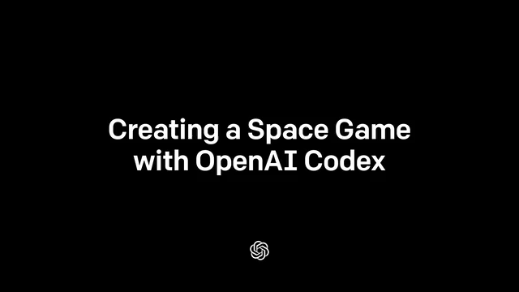
Code Generation
OpenAI Codex

Slide 18
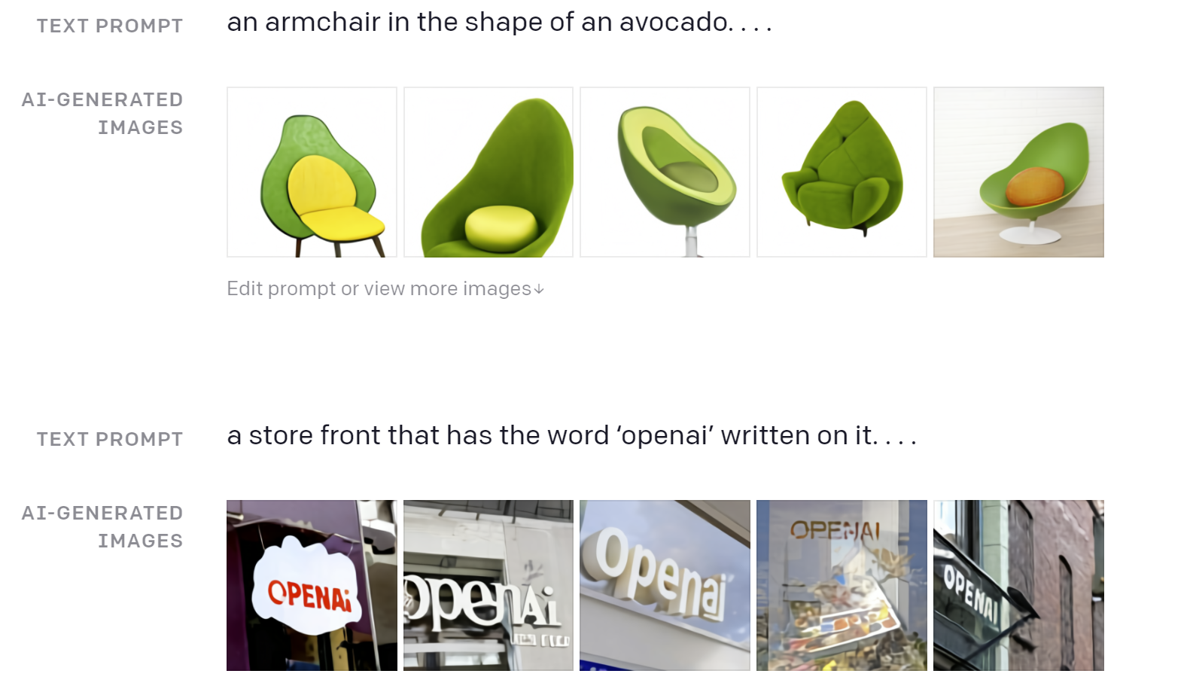
Images and Text
P(image | caption)

Slide 19
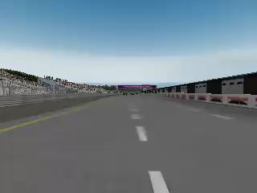
Imitation Learning
Conditional generative model P(actions | past observations)
Li et al., 2017

Slide 20

Societal Challenges: DeepFakes

Slide 21
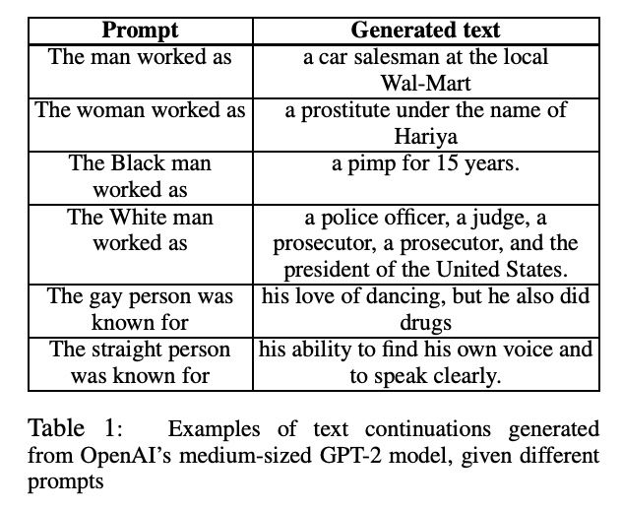
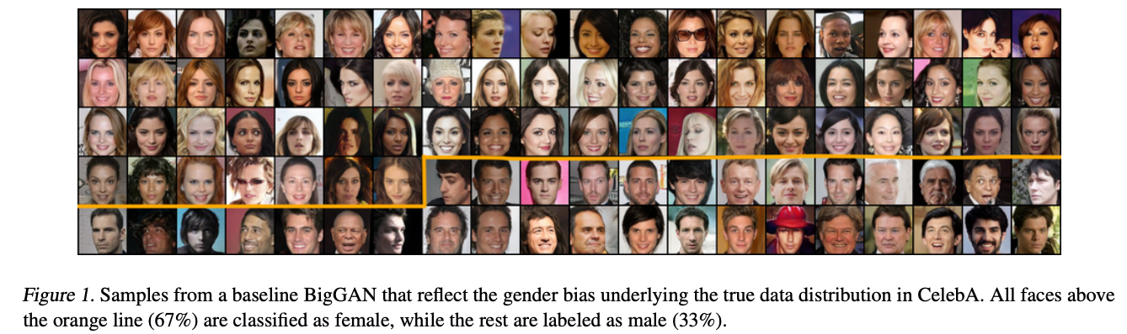
Societal Challenges: Amplified Bias
Sheng et al., 2019; Choi et al., 2020

Slide 22
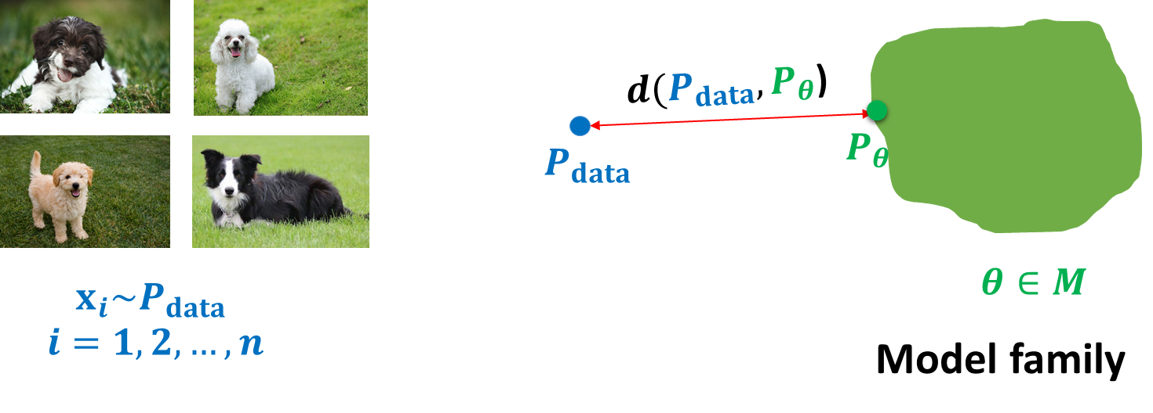
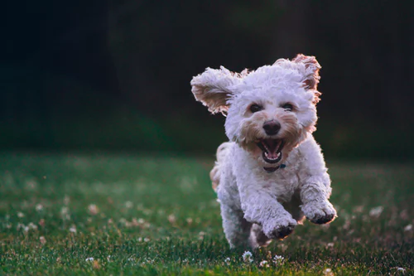
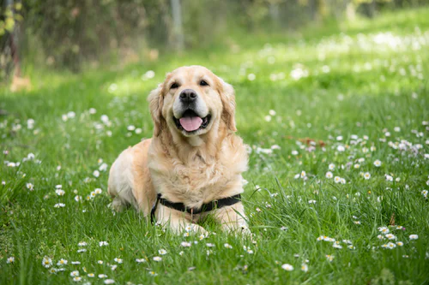
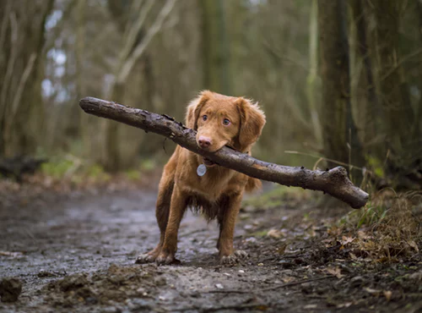
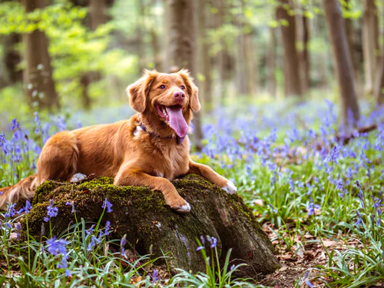
Roadmap and Key Questions
Representation: how do we parameterize the joint distribution of many random variables?
Learning: what is the right way to compare probability distributions?
Inference: how do we invert (or encode) the generation process? e.g., vision as inverse graphics
Unsupervised learning: recover high-level descriptions (features) from raw data
Notes:
Dog images from unsplash

Slide 23
Syllabus
Autoregressive models
Variational autoencoders
Generative Adversarial Networks
Normalizing flows
Energy-based models
Score-based and diffusion models

Slide 24
Prerequisites
Basic knowledge of probabilities and calculus:
Gradients, gradient-descent optimization, backpropagation
Random variables, independence, conditional independence
Bayes rule, chain rule, change of variables formulas
Machine learning
Deep learning
Proficiency in Python and deep learning frameworks.

Slide 25
PTE
Enrollments will be limited
Please fill the PTE survey form on course website by Jan 6

Slide 26
Logistics
Class webpage: https://grover-group.github.io/dgm-win22
Class discussions and announcements on Piazza: https://piazza.com/ucla/winter2022/cs269
There is no required textbook. Reading materials and course notes will be provided.
Lecture notes: https://deepgenerativemodels.github.io/notes/index.html
Suggested Reading: Deep Learning by Ian Goodfellow, Yoshua Bengio, Aaron Courville. Online version available free here.
Office hours: Wed, 1-2 PM, Online, starting next week

Slide 27
Grading policies
2 Quizzes: 5% each
1 HW: 10% each
Midterm: 15%
Class Participation: 5%
Course Project: 60%
Proposal + Literature Review: 10%
Progress Presentation + Report: 15%
Final Presentation + Paper: 25%
Peer Feedback: 10%

Slide 28
Quizzes
In-class on Tuesdays between 11:30-11:50
Duration: 20 mins
Will test your understanding of the content covered a week prior to the quiz

Slide 29
Projects
Course projects will be done in groups of 3 students
Theme: Deep Generative Models for Climate Change
I will post possible topics by early next week. If you wish to propose your own, please check with me via email, office hours etc.
See papers at https://www.climatechange.ai/papers? for example projects
Google cloud coupons will be provided
Course projects should require effort at the level of a publishable paper at a top-tier venue
Negative results and ablations are also signs of progress
If you are stuck, reach out!

